Slide 1
Concentration of Saltwater

Slide 2
Draw a Hydrogen Atom Label all protons, neutrons, electrons
Electron
Proton

Slide 3
Draw an Oxygen Atom Label all protons, neutrons, electrons
8 Electrons
8 Protons
8 Neutrons

Slide 4
Draw a WATER MOLECULE

Slide 5
Does water have a charge?
_
+
+
BIPOLAR

Slide 6
When you put salt into water what happens? DRAW IT!
Na+
Cl-
Na+
Cl-

Slide 7
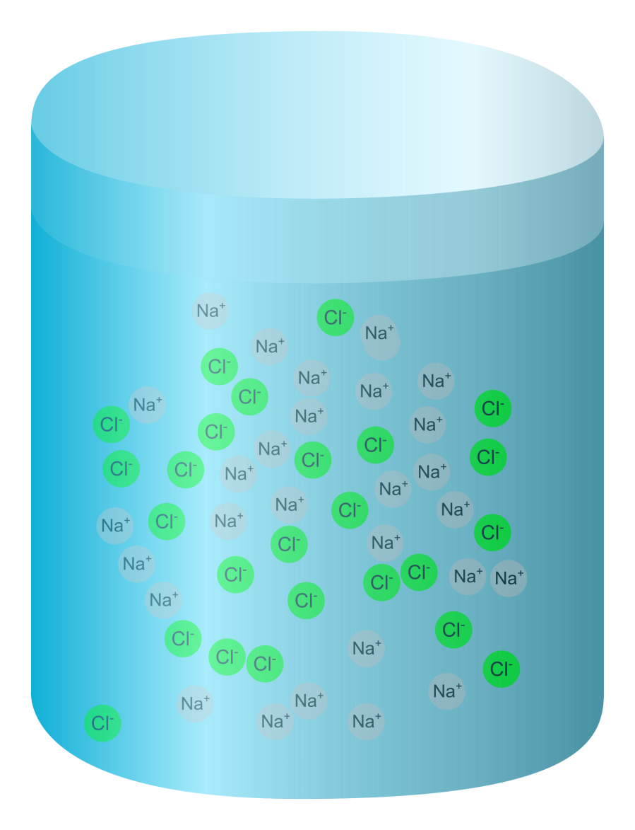
Identify properties of saltwater
Density
Viscosity
Conductivity
Boiling Point
Freezing Point
Salinity
pH
Solubility

Slide 8
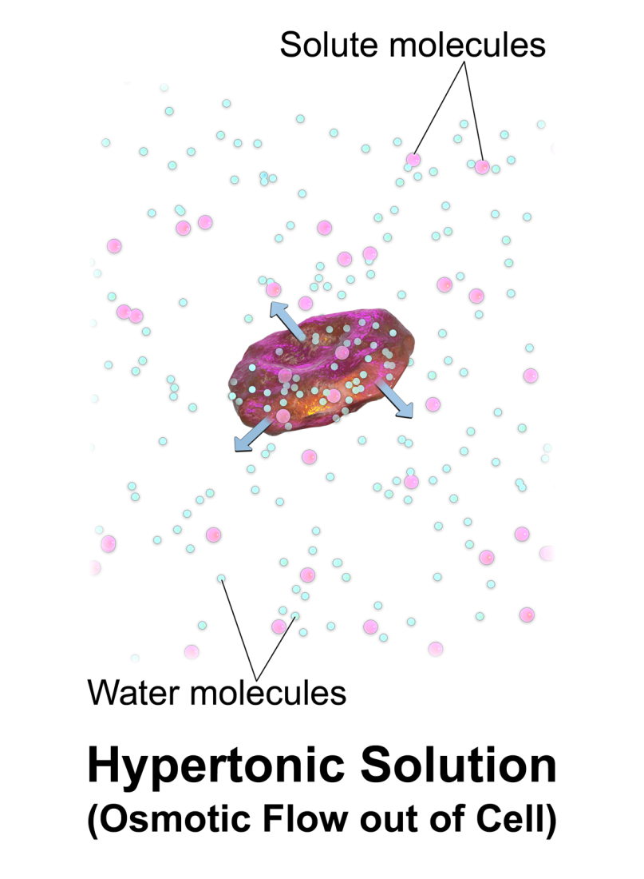
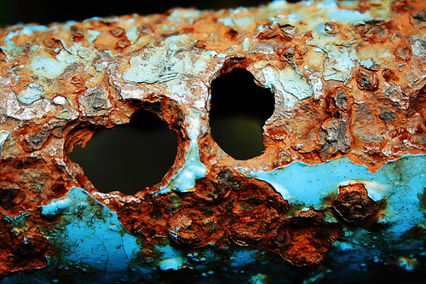
Issues with saltwater
Most Plants/Animals can’t use
Corrosion
Saltwater intrusion

Slide 9
Experiment
Design a method to determine the % of saltwater (salinity) in each container. It must be efficient, effective and minimize use of resources (CHEAP!).
RULES: CANNOT TASTE THE WATER
HINT: Acquire qualitative AND quantitative data.

